Slide 1
Project 7: NLP-Based Disaster Tweet Classification
Leveraging Machine Learning and Deep Learning for Real-Time Disaster Detection via Twitter
Submitted By: [Khushnaz]
Project assigning by : Nexthikes
Date: 30th July 2025

Slide 2
Background & Motivation
Twitter plays a vital role in disseminating information during disasters.
Millions of tweets are generated, but not all indicate real emergencies.
Distinguishing between real disaster alerts and unrelated or metaphorical mentions is challenging.
This project aims to automate disaster tweet classification using NLP.

Slide 3
Problem Statement
Classify whether a tweet is about a real disaster or not.
Tweets may contain ambiguous, sarcastic, or metaphorical language.
The model must accurately understand context and meaning.
Project Objectives
Build ML and DL models for classifying disaster-related tweets.
Achieve high accuracy, precision, and recall.
Ensure robustness against slang, misspellings, abbreviations, and noise.
Design a web interface for public use.
Enable scalability for real-time tweet classification.

Slide 4
Dataset Overview
Total tweets: 10,000 (manually labeled)
Classes:
1 = Disaster tweet
0 = Non-disaster tweet
Each entry contains tweet text and a binary label.
Load dataset and info , missing value, head, tail and dtype , columns and shape ,describe and filling missing values and duplicated values after this process and nor preprocess next step

Slide 5
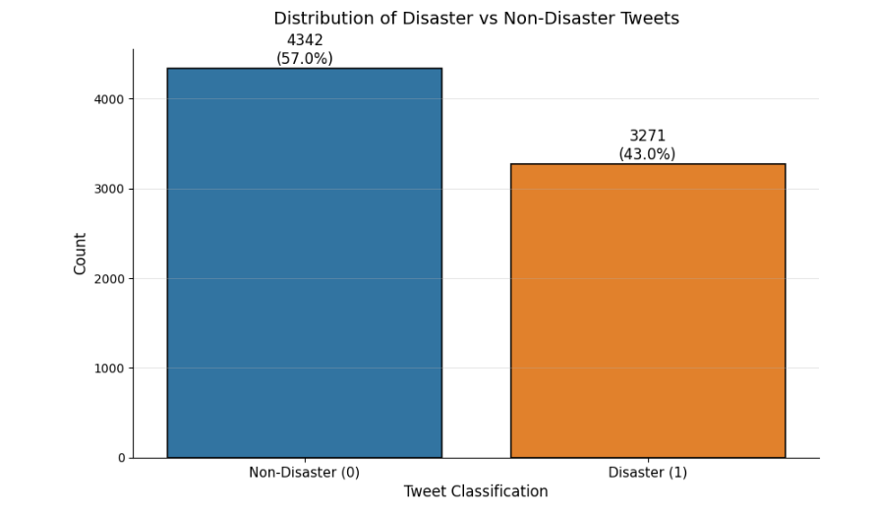
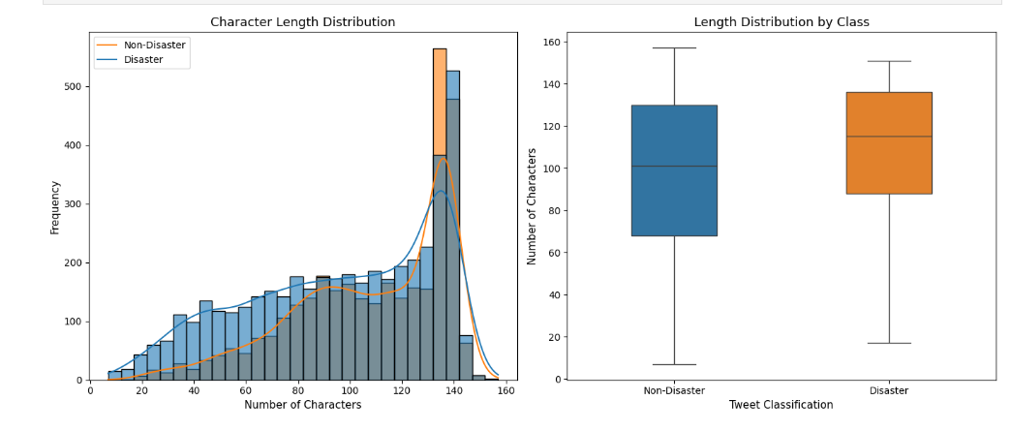
Data Preprocessing
After dataset and nor preprocessing
Removed:
URLs, HTML tags, special characters, emojis
Applied:
Lowercasing
Tokenization
Stopword removal
Converted labels: 1 = Disaster, 0 = Not Disaster
Split data into train-test sets (80:20)
and length class and distribution and keyword frequency
And word frequency comparison

Slide 6
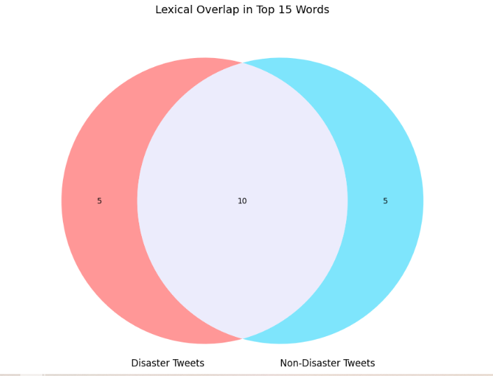
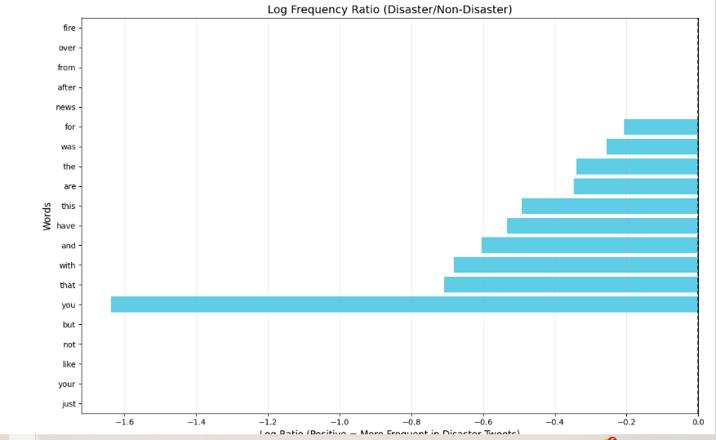
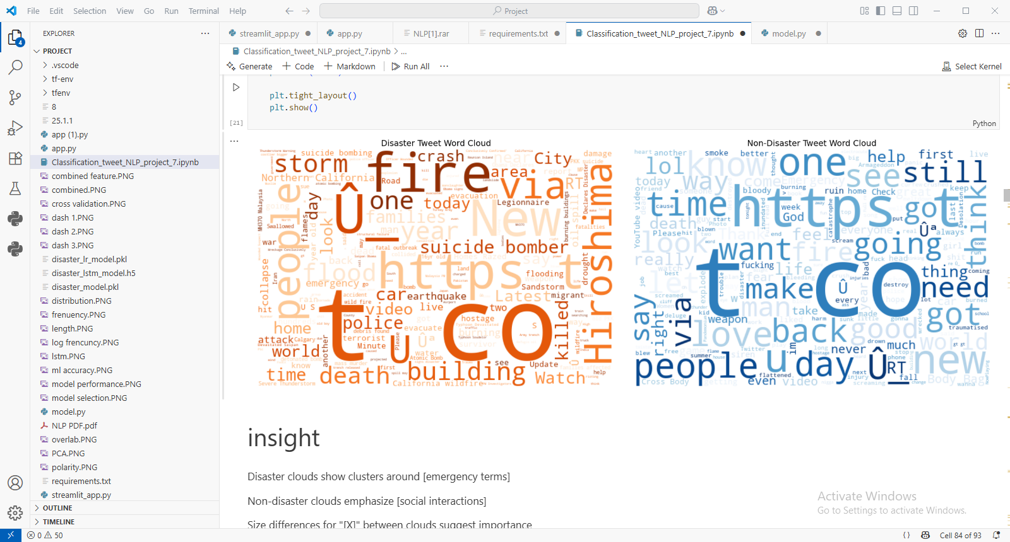

Slide 7
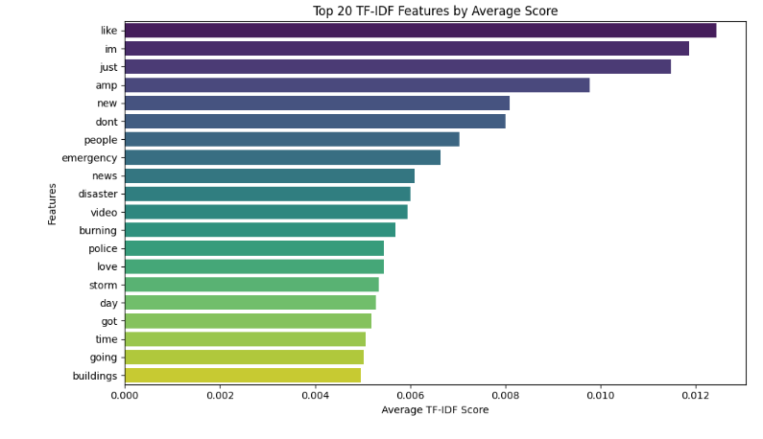
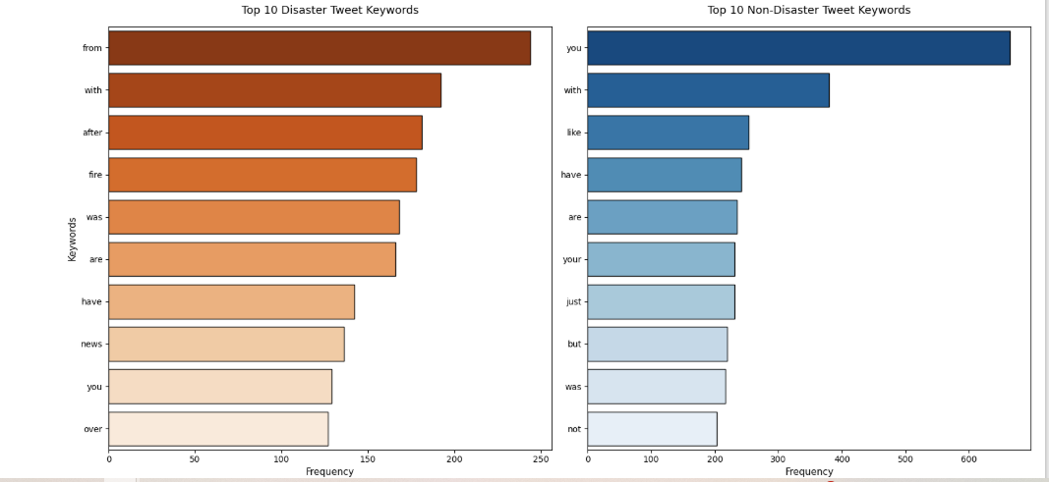
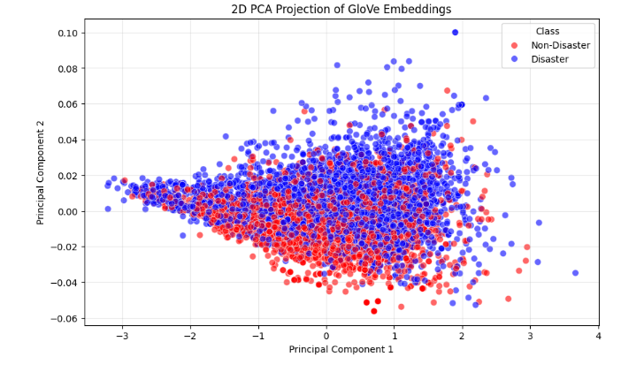
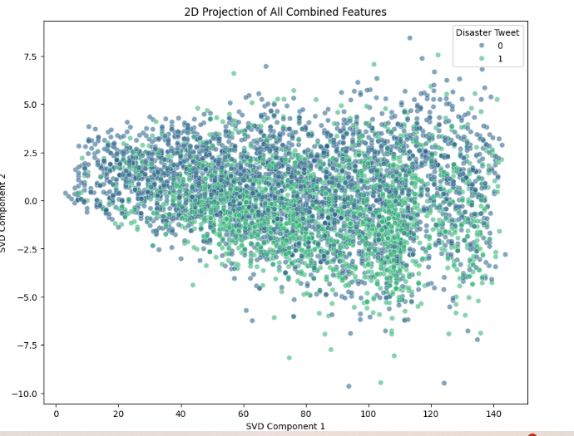
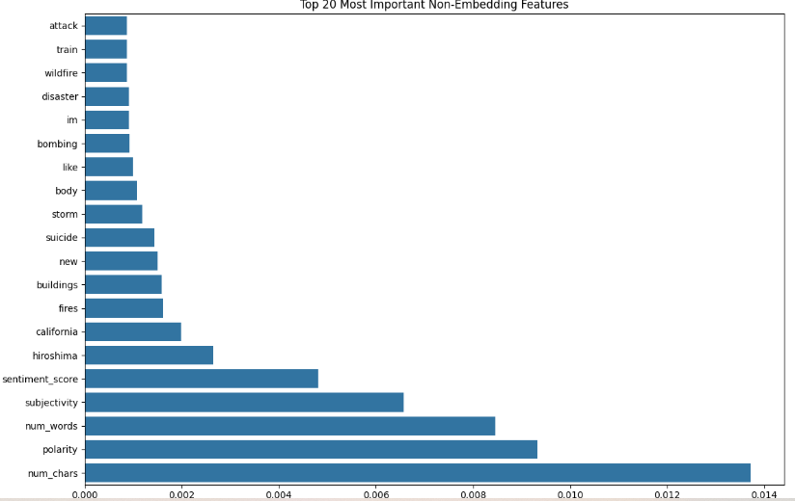
Feature Engineering
For ML Model:
TF-IDF vectorization
N-grams, word frequency
For DL Model:
Tokenizer + Sequences
Padded to uniform length = 100
Used Embedding Layer
Optional: tweet length, hashtags, mentions

Slide 8
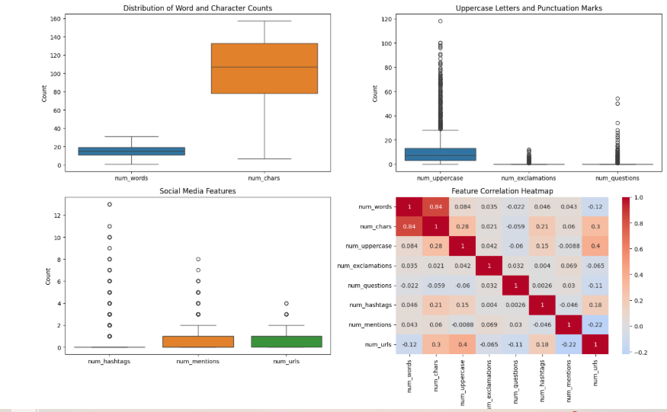
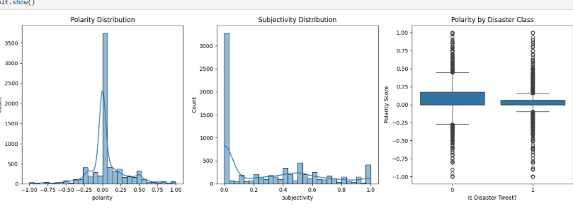

Slide 9
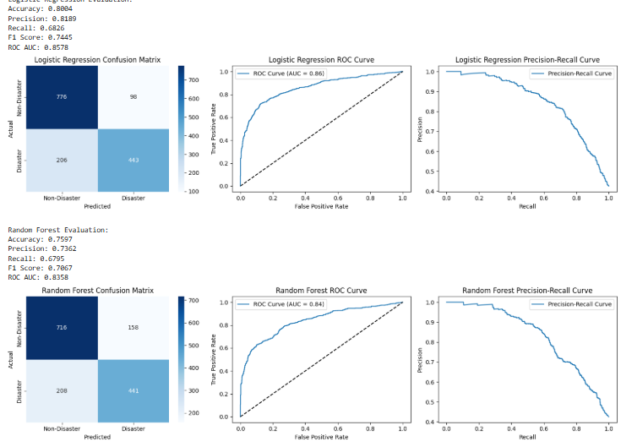
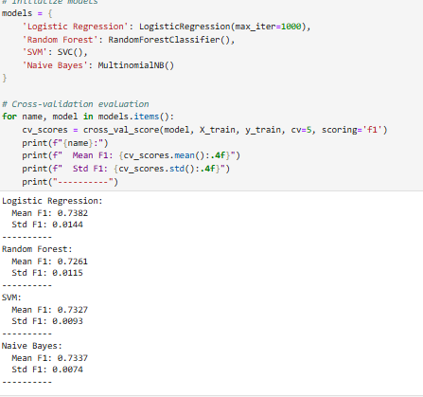
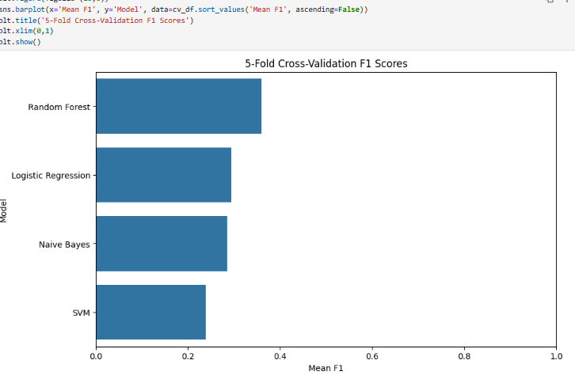
Machine Learning Model
Model Used: Logistic Regression
Technique: TF-IDF + Logistic Regression
Performance Metrics:
Accuracy: 92.3%
Precision: 89.5%
Recall: 85.2%
F1 Score: 87.3%

Slide 10
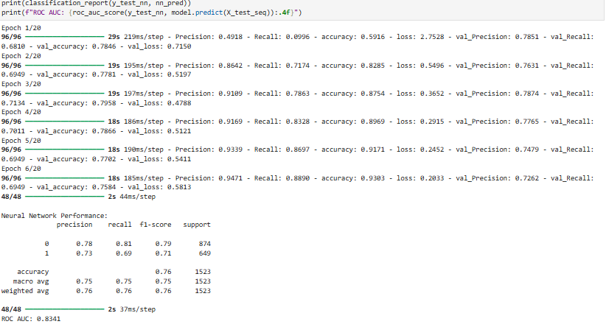
Deep Learning Model
Architecture:
Embedding Layer → LSTM → Dense
Input: Padded Sequences (length=100)
Loss Function: Binary Crossentropy
Optimizer: Adam
Output: Probability (≥0.5 = Disaster)

Slide 11
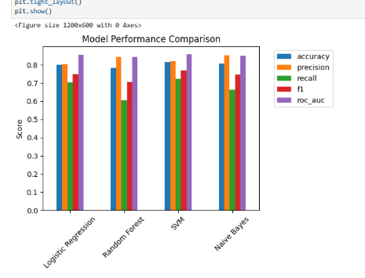
Model Evaluation
Compared ML and DL models using test set
Evaluation Metrics: Accuracy, Precision, Recall, F1 Score
Visuals: Confusion Matrix, Confidence Bar Plot
Both models achieved strong, comparable results

Slide 12
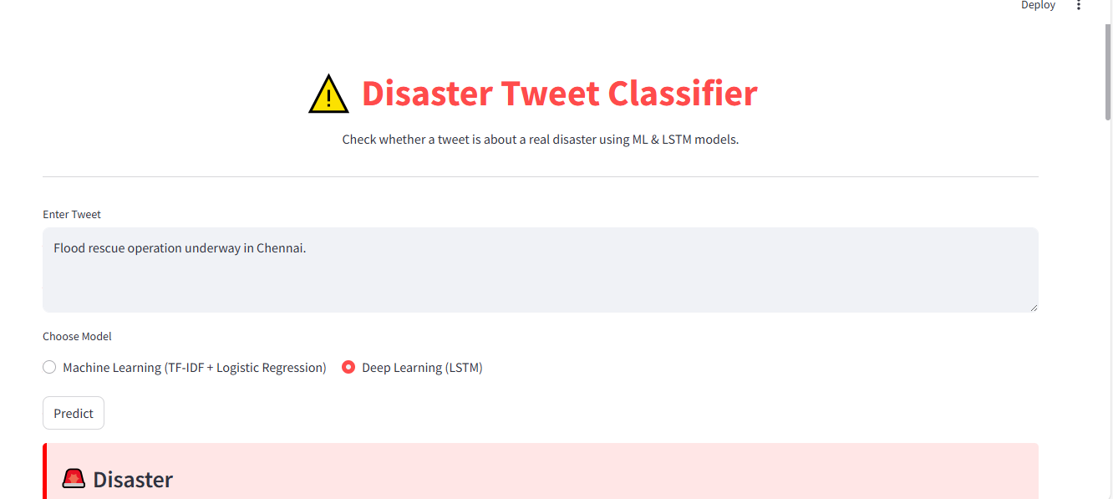
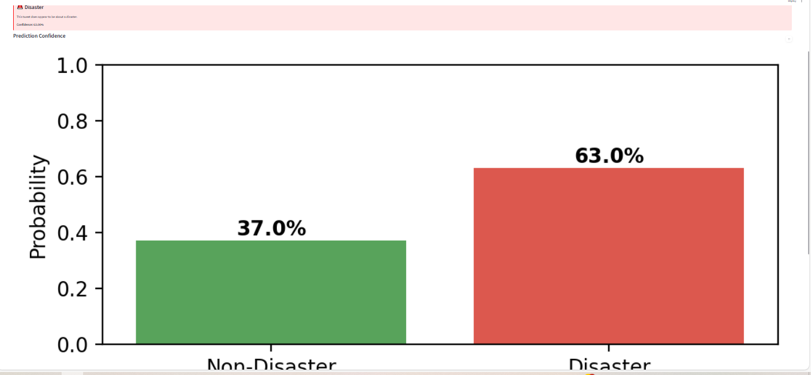
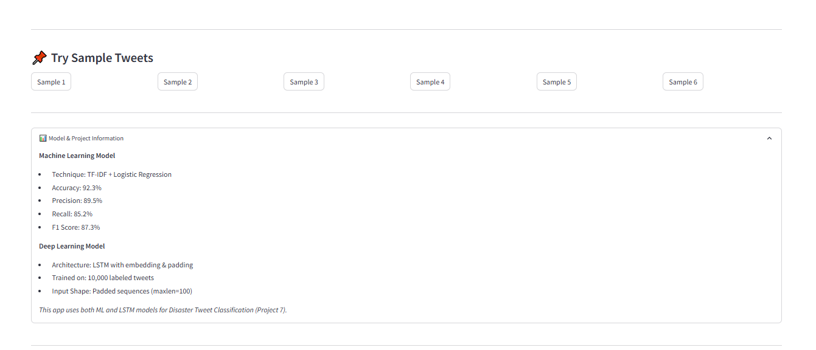
Web App Interface
Framework Used: Streamlit
Key Features:
Text input box
Model selector: ML or LSTM
Confidence % and visualization
Sample tweet buttons
Provides instant classification & interpretation

Slide 13
Deployment Artifacts Saved:
ML model: disaster_model.pkl
Vectorizer: tfidf_vectorizer.pkl
DL model: disaster_lstm_model.h5
Tokenizer: tokenizer.pkl
Frontend: Streamlit UI (app.py)
Ready for deployment on github etc. .

Slide 14
Future Scope
Integrate live Twitter streaming via Tweepy
Add multi-language tweet support
Geo-tag tweets to visualize disaster hotspots
Expand to classify disaster type (e.g., flood, fire, earthquake)

Slide 15
Conclusion
: Successfully classified disaster-related tweets using both ML and DL.
The models are robust, scalable, and fast.
The web interface enables real-time tweet screening.
This project demonstrates the practical application of NLP for social good.

Slide 16
Thank you

